Slide 1
Chongqing University of Technology
ATAI
Advanced Technique of Artificial Intelligence
Chongqing University of Technology
Spatial-Temporal Knowledge Distillation for Takeaway Recommendation
Code：None
2025.3.10 • ChongQing
—— AAAI 2025
Reported by Peng Shan

Slide 2
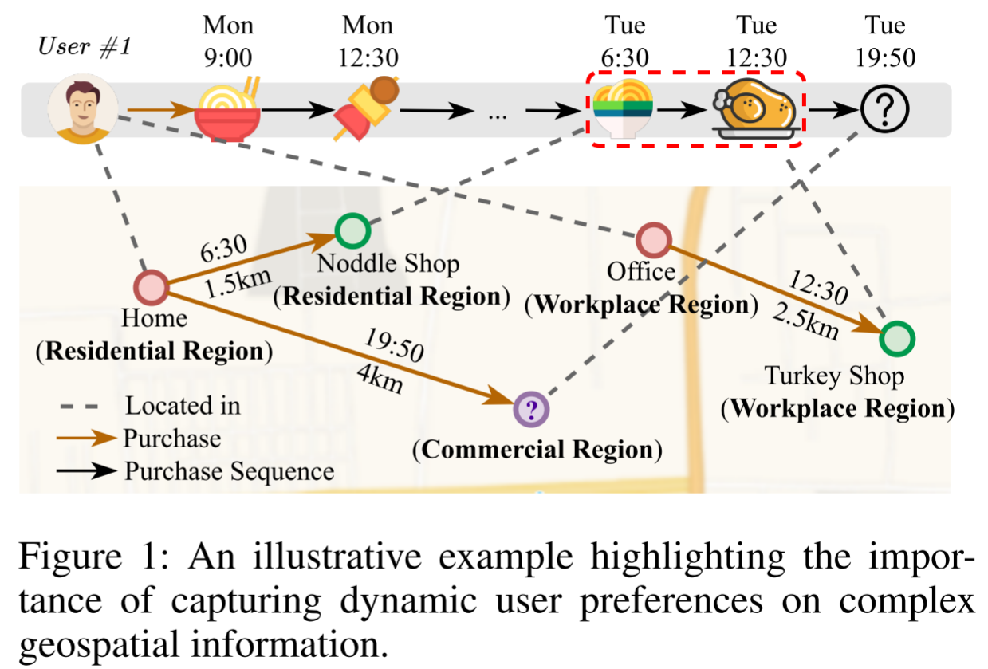
Motivation
(1) Failing to effectively capture dynamic user preferences on complex geospatial information.
(2) How to efficiently integrate spatial-temporal knowledge from both graphs and sequence data with low computational costs.

Slide 3
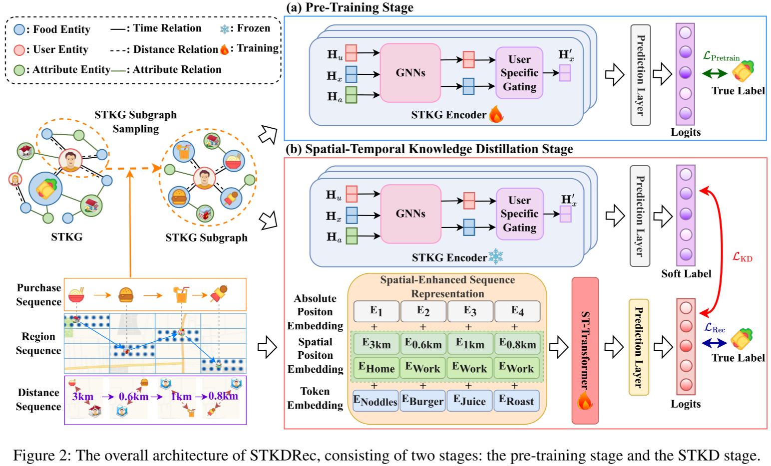
Method

Slide 4
Method

Slide 5
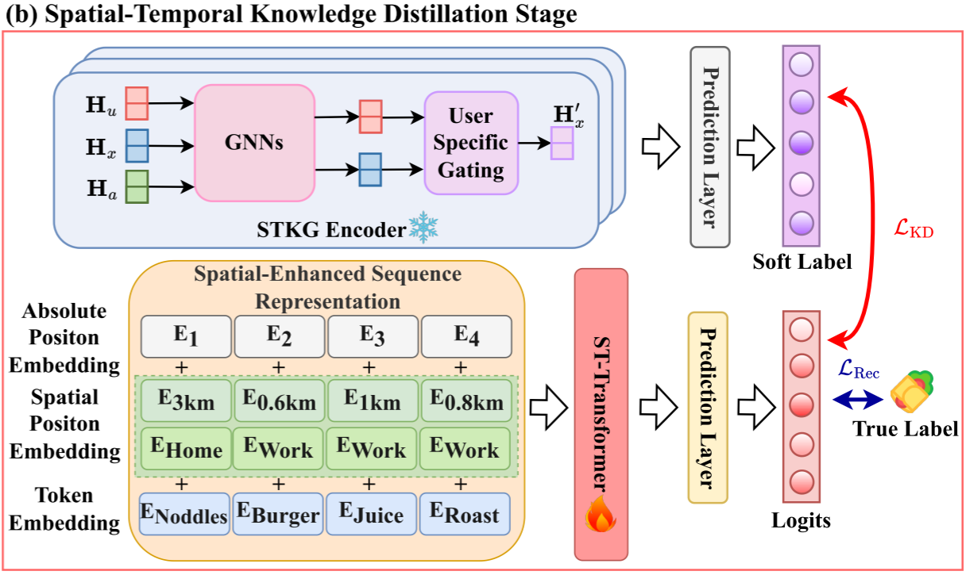
Method

Slide 6
Experiments

Slide 7
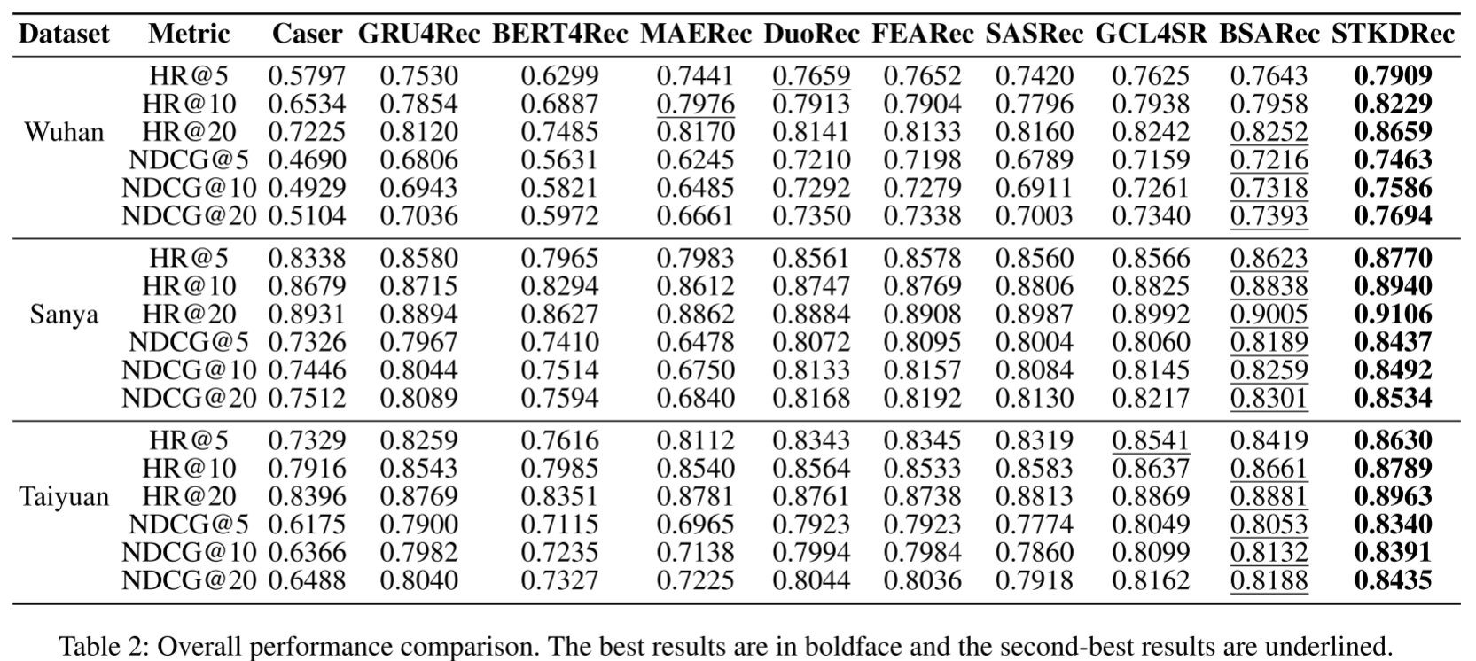
Experiments

Slide 8
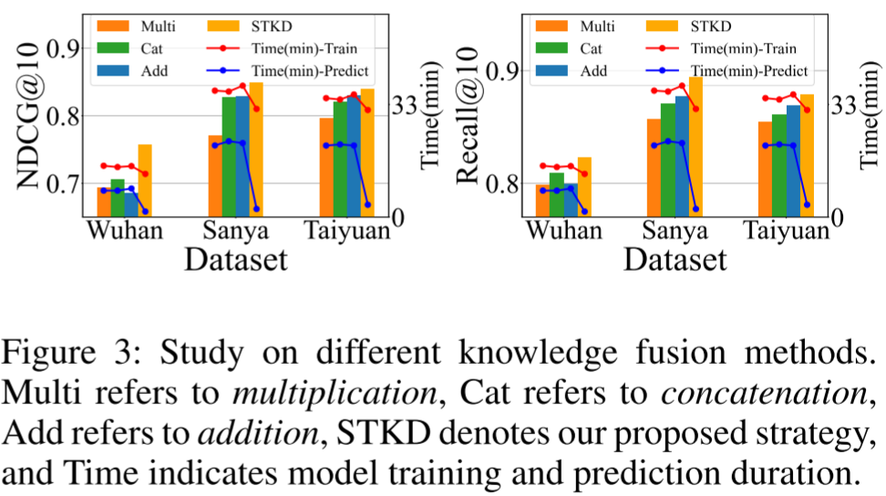
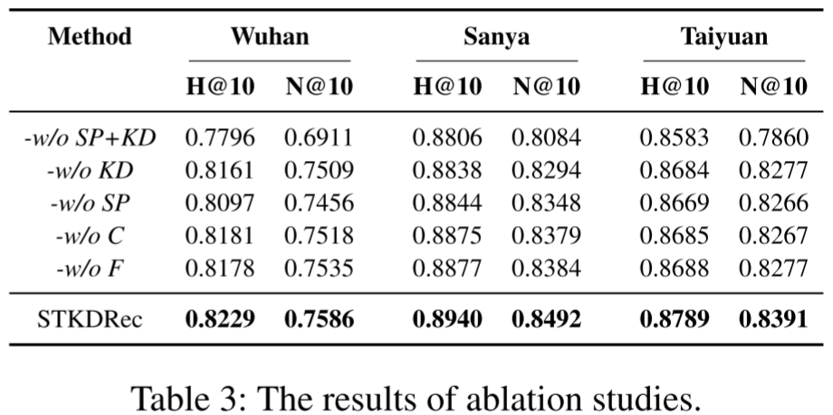
Experiments

Slide 9
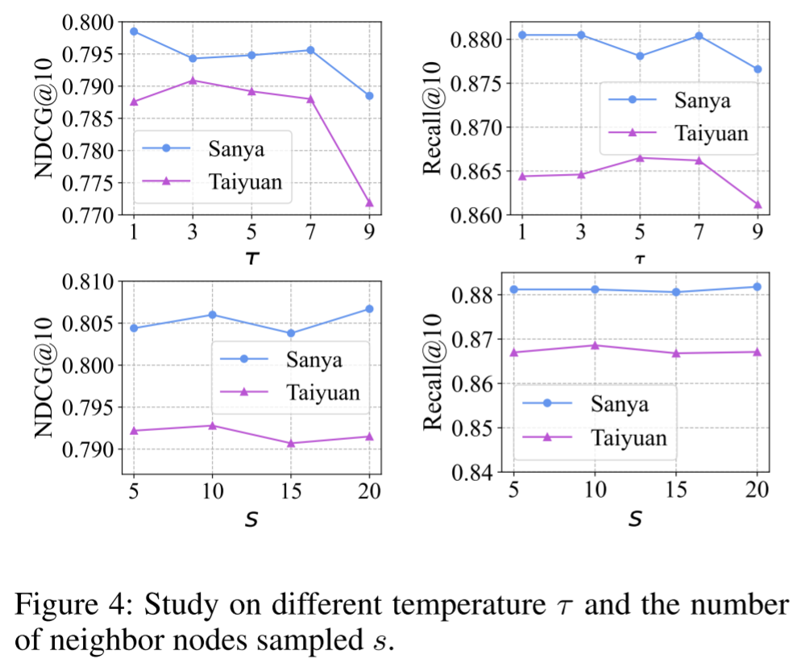
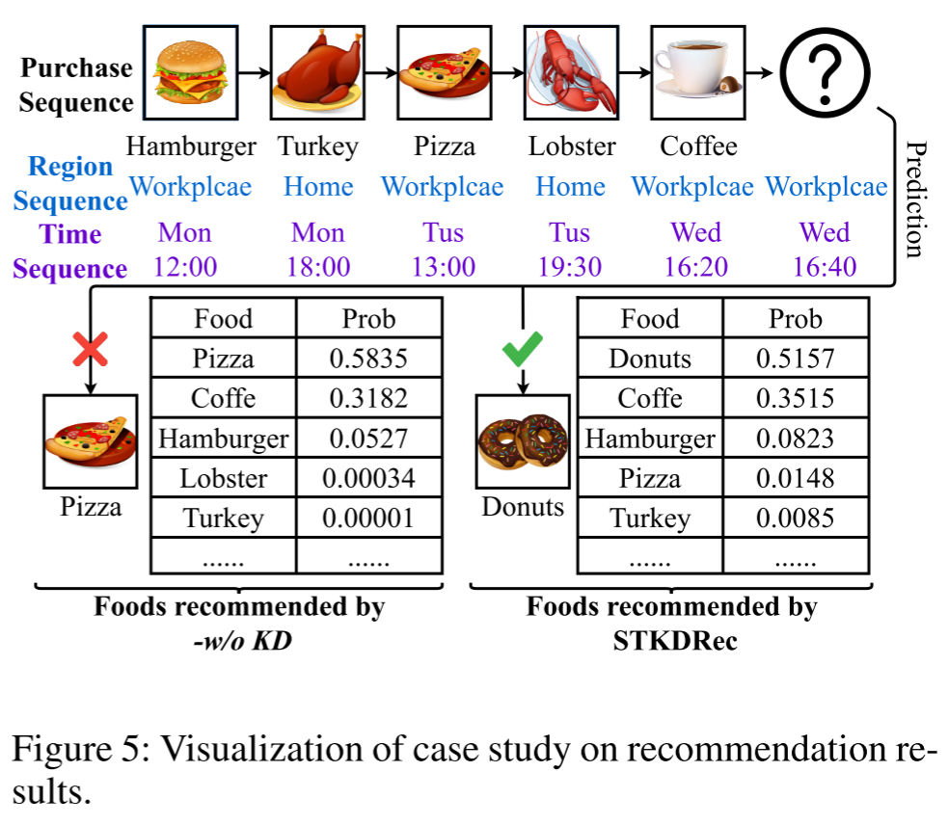
Experiments

Slide 10
Thanks!

